Slide 1


Data Mining Essentials
SOCIAL
MEDIA
MINING

Slide 2
Dear instructors/users of these slides: Please feel free to include these slides in your own material, or modify them as you see fit. If you decide to incorporate these slides into your presentations, please include the following note:
R. Zafarani, M. A. Abbasi, and H. Liu, Social Media Mining: An Introduction, Cambridge University Press, 2014.
Free book and slides at http://socialmediamining.info/
or include a link to the website: http://socialmediamining.info/

Slide 3

Introduction
Data production rate has increased dramatically (Big Data) and we are able store much more data
E.g., purchase data, social media data, cellphone data
Businesses and customers need useful or actionable knowledge to gain insight from raw data for various purposes
It’s not just searching data or databases
The process of extracting useful patterns from raw data is known as Knowledge Discovery in Databases (KDD)

Slide 4
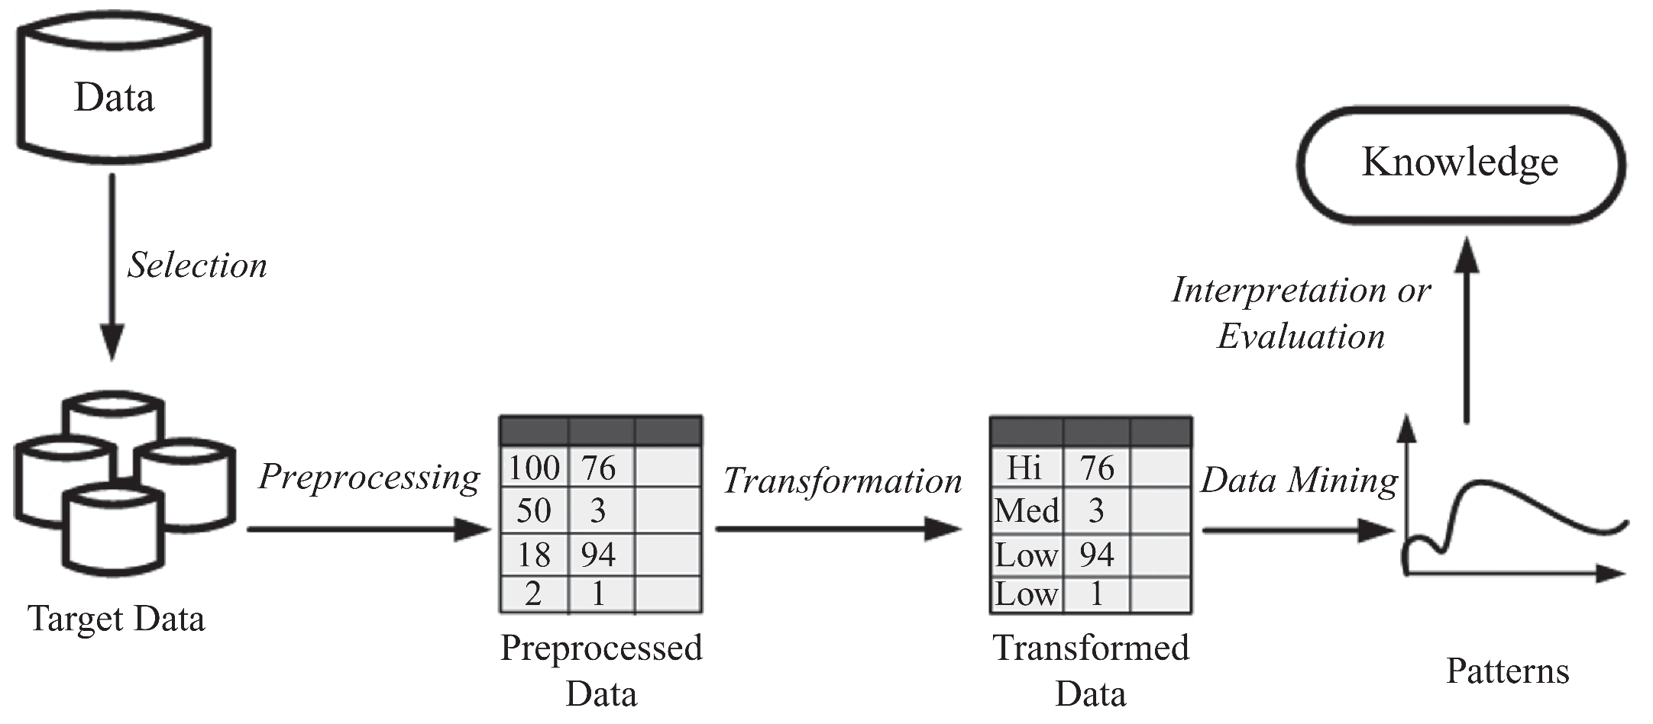
KDD Process

Slide 5
Collecting Data on Social Media
Collect Raw Data
Use site provided APIs
Flickr’s: https://www.flickr.com/services/api/
Scrape information directly
Use Provided Repositories
http://socialcomputing.asu.edu
http://snap.Stanford.edu
https://github.com/caesar0301/awesome-public-datasets

Slide 6
Data Mining
Data Mining: the process of discovering hidden and actionable patterns from data
It utilizes methods at the intersection of artificial intelligence, machine learning, statistics, and database systems
Extracting/“mining” knowledge from large-scale data (big data)
Data-driven discovery and modeling of hidden patterns in big data
Extracting information/knowledge from data that is
implicit,
previously unknown,
unexpected, and
potentially useful

Slide 7
Data Mining vs. Databases
Data mining is the process of extracting hidden and actionable patterns from data
Database systems store and manage data
Queries return part of stored data
Queries do not extract hidden patterns
Examples of querying databases
Find all employees with income more than $250K
Find top spending customers in last month
Find all students from engineering college with GPA more than average

Slide 8
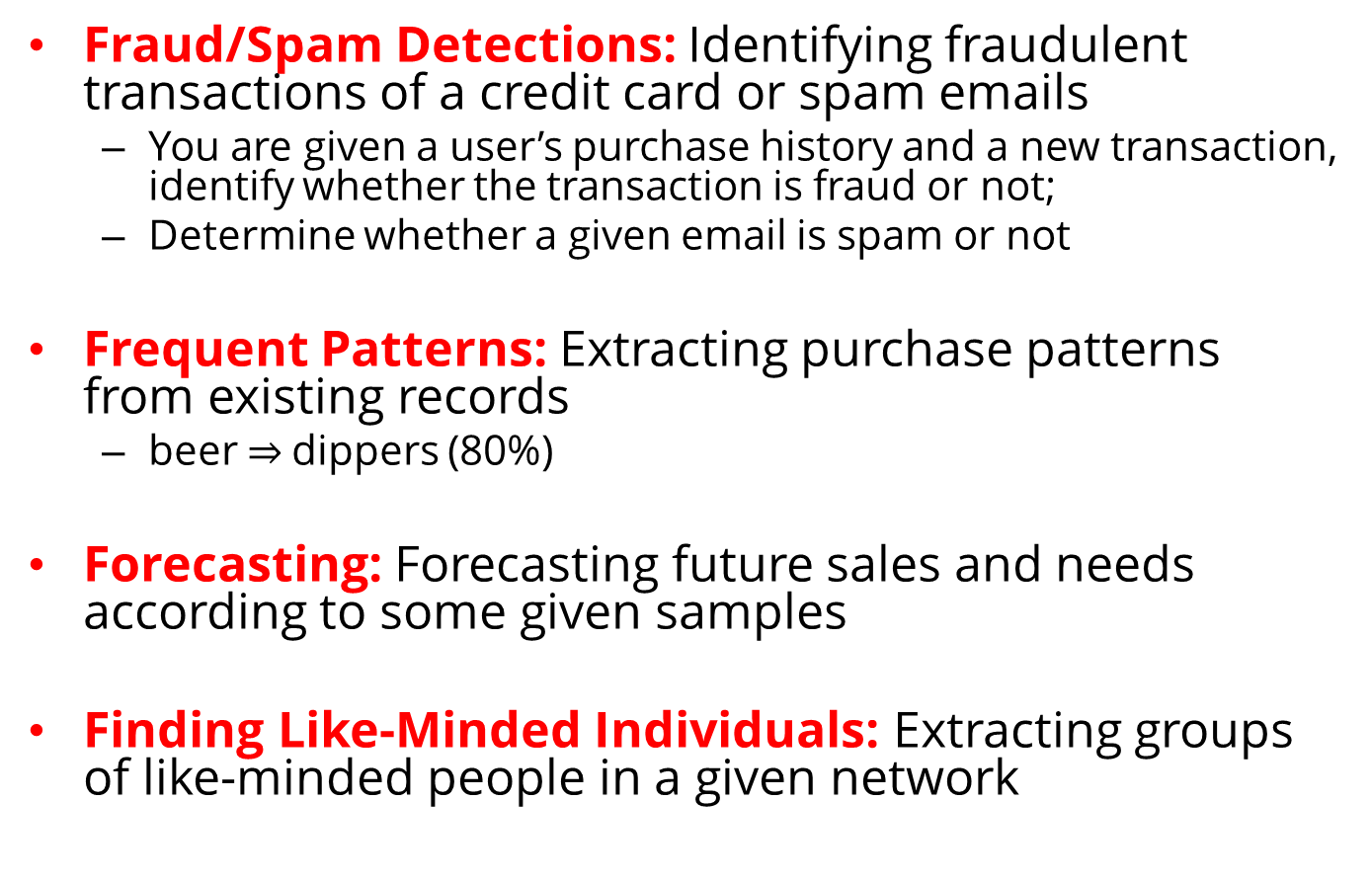
Examples of Data Mining Applications
Fraud/Spam Detections: Identifying fraudulent transactions of a credit card or spam emails
You are given a user’s purchase history and a new transaction, identify whether the transaction is fraud or not;
Determine whether a given email is spam or not
Frequent Patterns: Extracting purchase patterns from existing records
beer $⇒$dippers (80%)
Forecasting: Forecasting future sales and needs according to some given samples
Finding Like-Minded Individuals: Extracting groups of like-minded people in a given network
Notes:
Beer and chips are not interesting patterns, for example.

Slide 9
Data

Slide 10
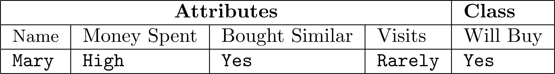
Data Instances
In the KDD process,
Data is in a tabular format (a set of instances)
Each instance is a collection of properties and features related to an object or person
A patient’s medical record
A user’s profile
A gene’s information
Instances are also called points, data points, or observations
Feature Value
Class Attribute
Data Instance:
Features ( Attributes or measurements)
Class Label

Slide 11
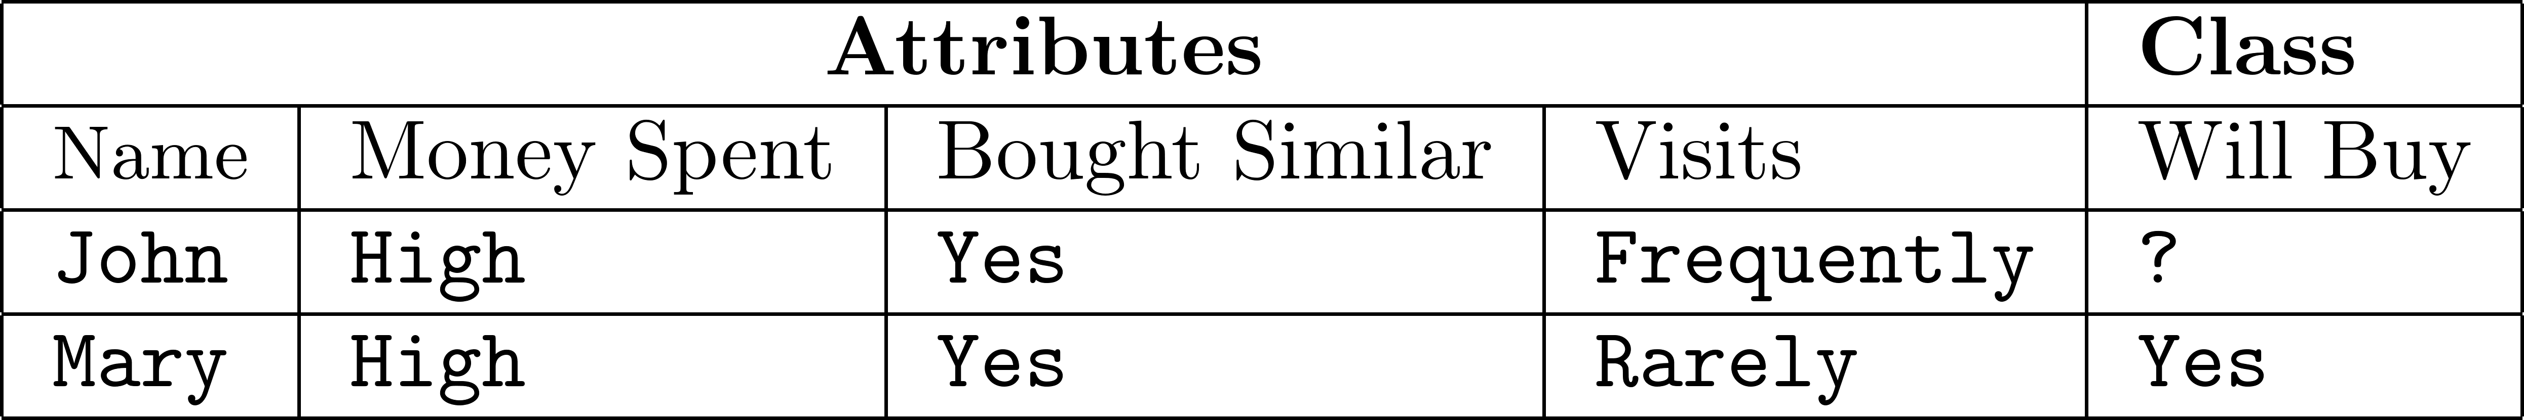
Data Instances
Predicting whether an individual who visits an online book seller is going to buy a specific book
Features can be
Continues: values are numeric values
Money spent: $25
Discrete: can take a number of values
Money spent: {high, normal, low}
Unlabeled
Example
Labeled
Example

Slide 12
Data Types + Permissible Operations (statistics)
Nominal
Operations:
Mode (most common feature value), Equality Comparison
E.g., {male, female}
Ordinal
Feature values have an intrinsic order to them, but the difference is not defined
Operations:
same as nominal, feature value rank
E.g., {Low, medium, high}
Interval
Operations:
Addition and subtractions are allowed whereas divisions and multiplications are not
E.g., 3:08 PM, calendar dates
Ratio
Operations:
divisions and multiplications are allowed
E.g., Height, weight, money quantities

Slide 13
Sample Dataset – Twitter Users
Activity | Date Joined | Number of Followers | Verified Account? | Has Profile Picture?
High | 2015 | 50 | FALSE | no
High | 2013 | 300 | TRUE | no
Average | 2011 | 860000 | FALSE | yes
Low | 2012 | 96 | FALSE | yes
High | 2008 | 8,000 | FALSE | yes
Average | 2009 | 5 | TRUE | no
Very High | 2010 | 650,000 | TRUE | yes
Low | 2010 | 95 | FALSE | no
Average | 2011 | 70 | FALSE | yes
Very High | 2013 | 80,000 | FALSE | yes
Low | 2014 | 70 | TRUE | yes
Average | 2013 | 900 | TRUE | yes
High | 2011 | 7500 | FALSE | yes
Low | 2010 | 910 | TRUE | no
Ordinal
Interval
Ratio
Nominal
Nominal
Notes:
Weather dataset

Slide 14
Text Representation
The most common way to represent documents is to transform them into vectors
Process them with linear algebraic operations
This representation is called “Bag of Words”
Vector Space Model
Weights for words can be assigned by TF-IDF

Slide 15
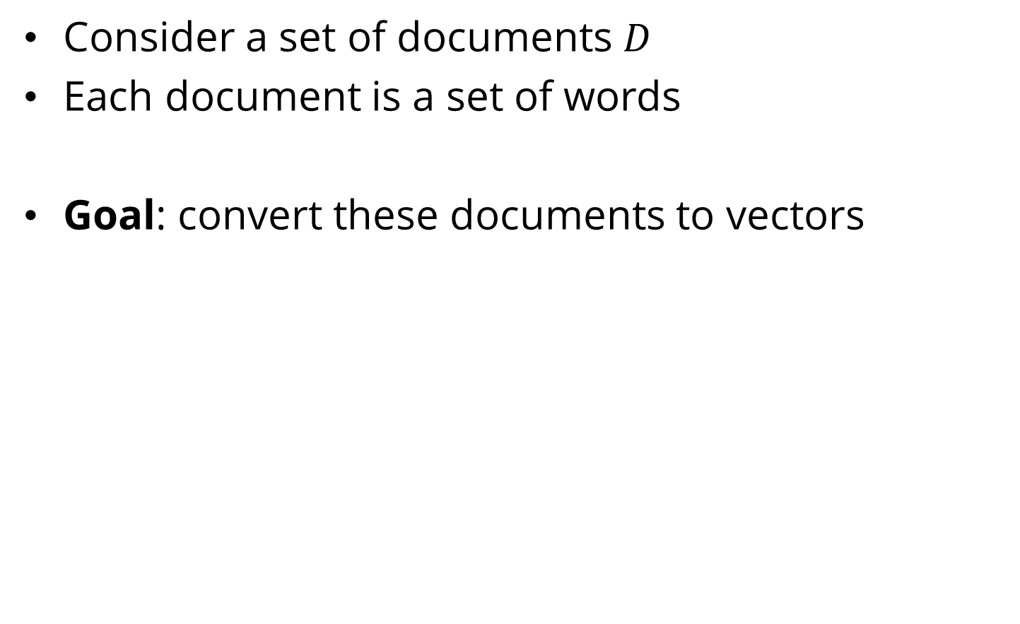
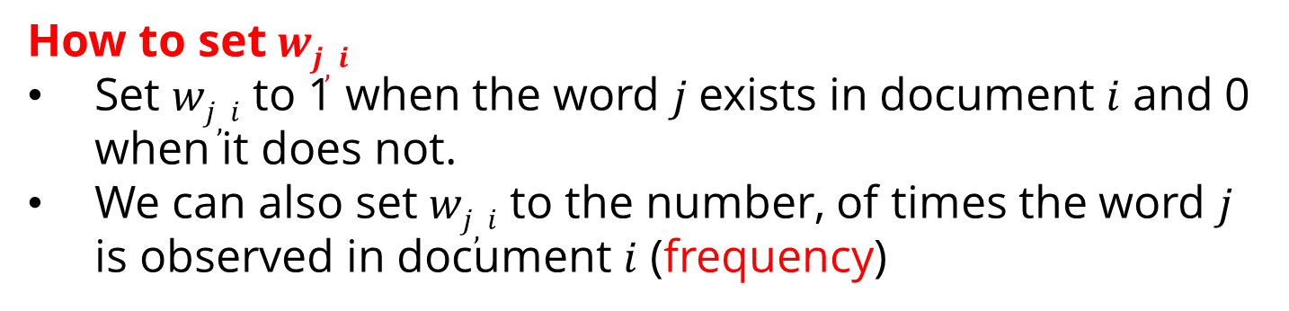
Vector Space Model
Consider a set of documents $D$
Each document is a set of words
Goal: convert these documents to vectors
$di$ : document $i$
$wj,i$ : the weight for word $j$ in document $i$
How to set $wj,i$
Set $wj,i$ to 1 when the word $j$exists in document $i$ and 0 when it does not.
We can also set $wj,i$ to the number, of times the word $j$ is observed in document $i$ (frequency)

Slide 16
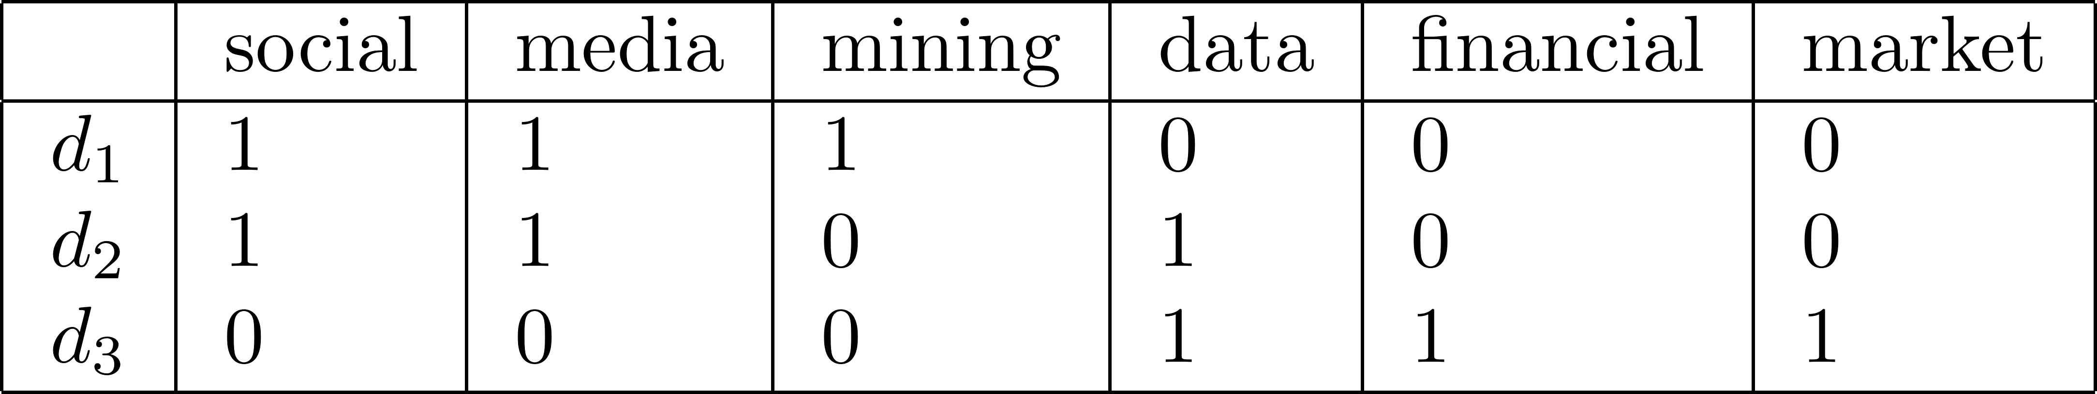
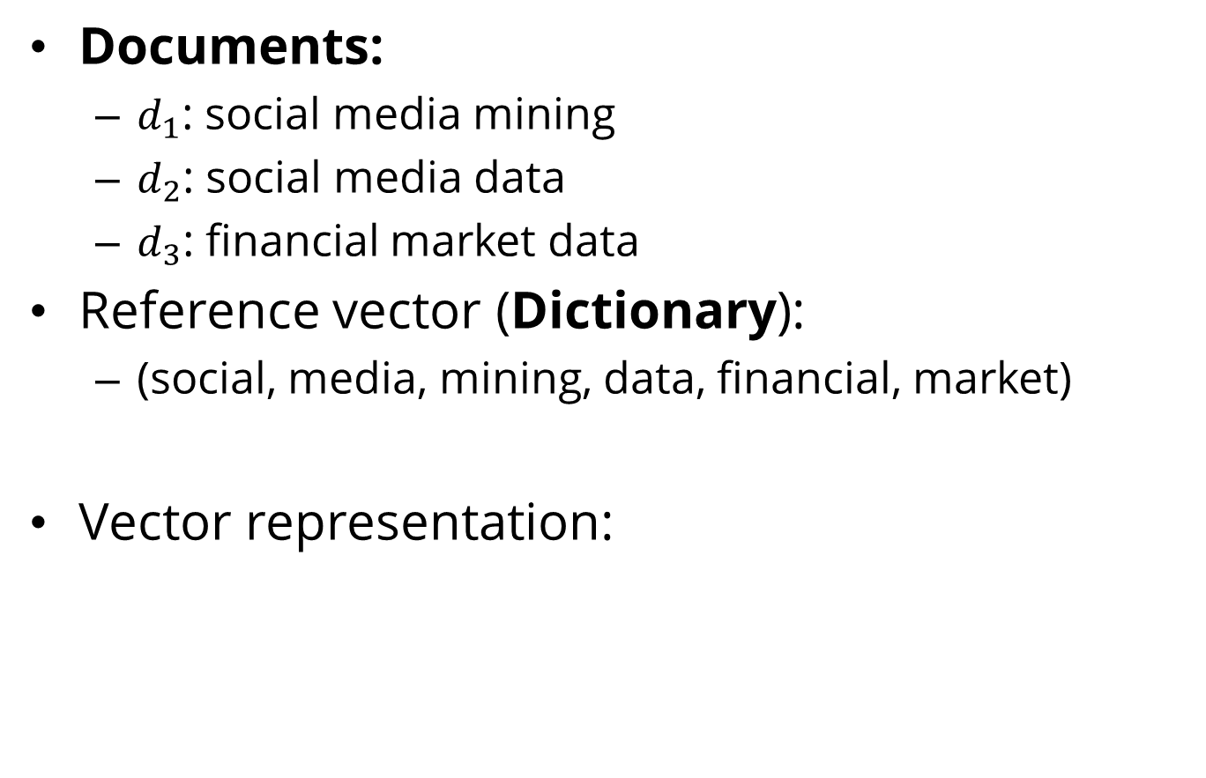
Vector Space Model: An Example
Documents:
$d_{1}$: social media mining
$d_{2}$: social media data
$d_{3}$: financial market data
Reference vector (Dictionary):
(social, media, mining, data, financial, market)
Vector representation:

Slide 17
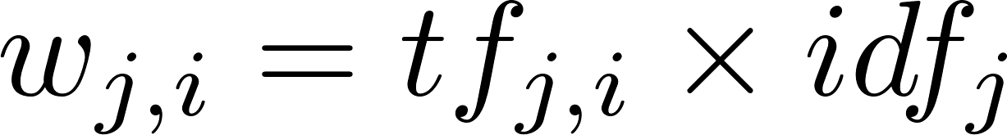
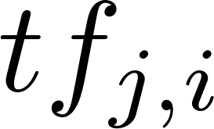
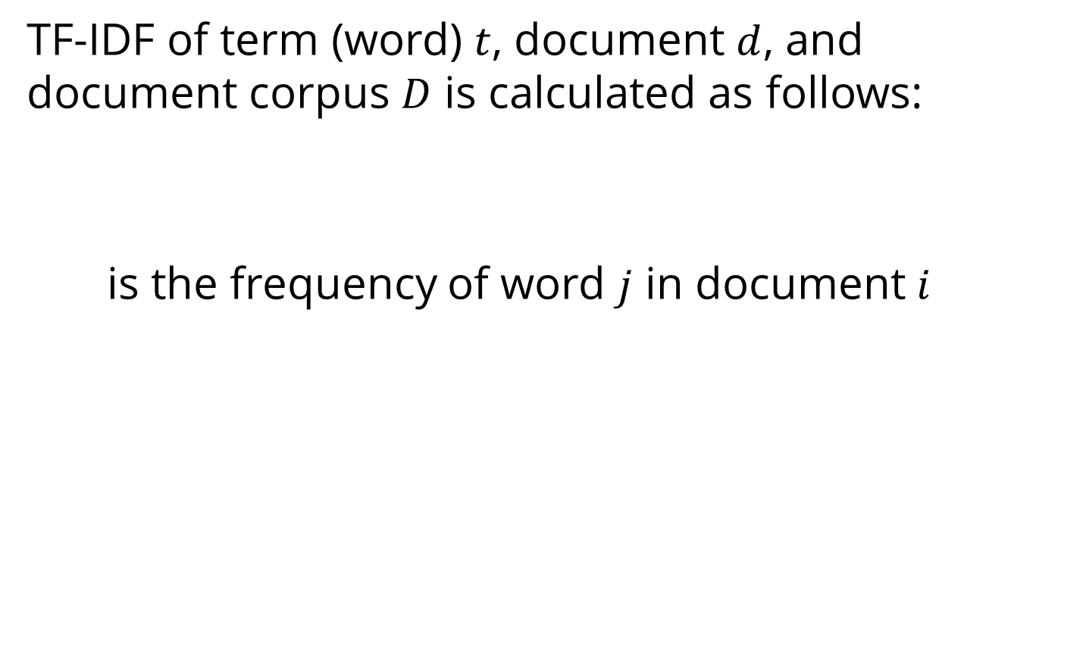
TF-IDF (Term Frequency-Inverse Document Frequency)
TF-IDF of term (word) $t$, document $d$, and document corpus $D$ is calculated as follows:
is the frequency of word $j$ in document $i$
The total number of documents in the corpus
The number of documents where the term $j$appears
Notes:
number of documents where the term t appears

Slide 18
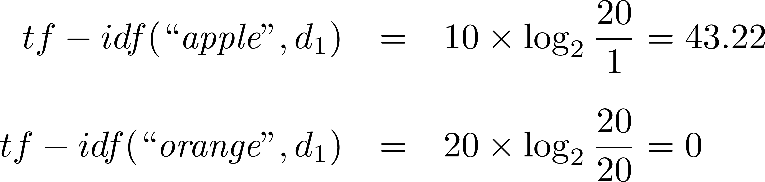
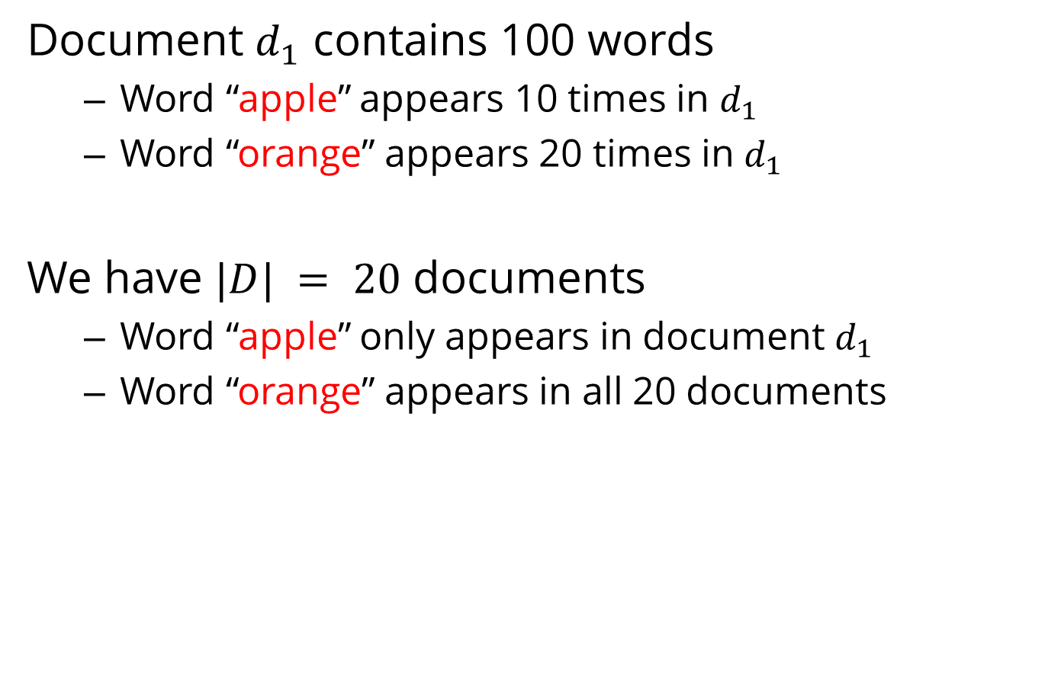
TF-IDF: An Example
Document $d_{1}$ contains 100 words
Word “apple” appears 10 times in $d_{1}$
Word “orange” appears 20 times in $d_{1}$
We have $|D| = 20$ documents
Word “apple” only appears in document $d_{1}$
Word “orange” appears in all 20 documents

Slide 19
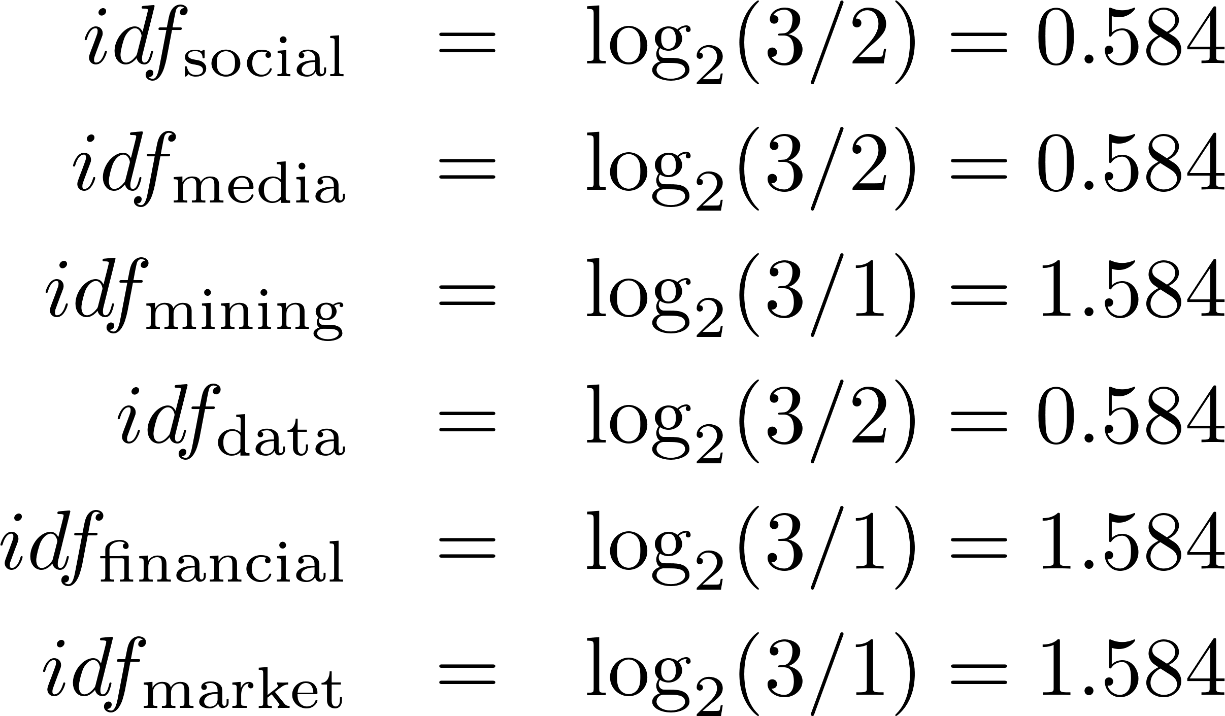
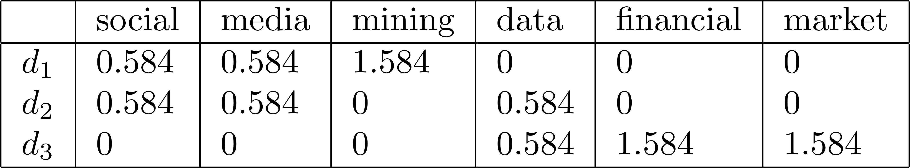
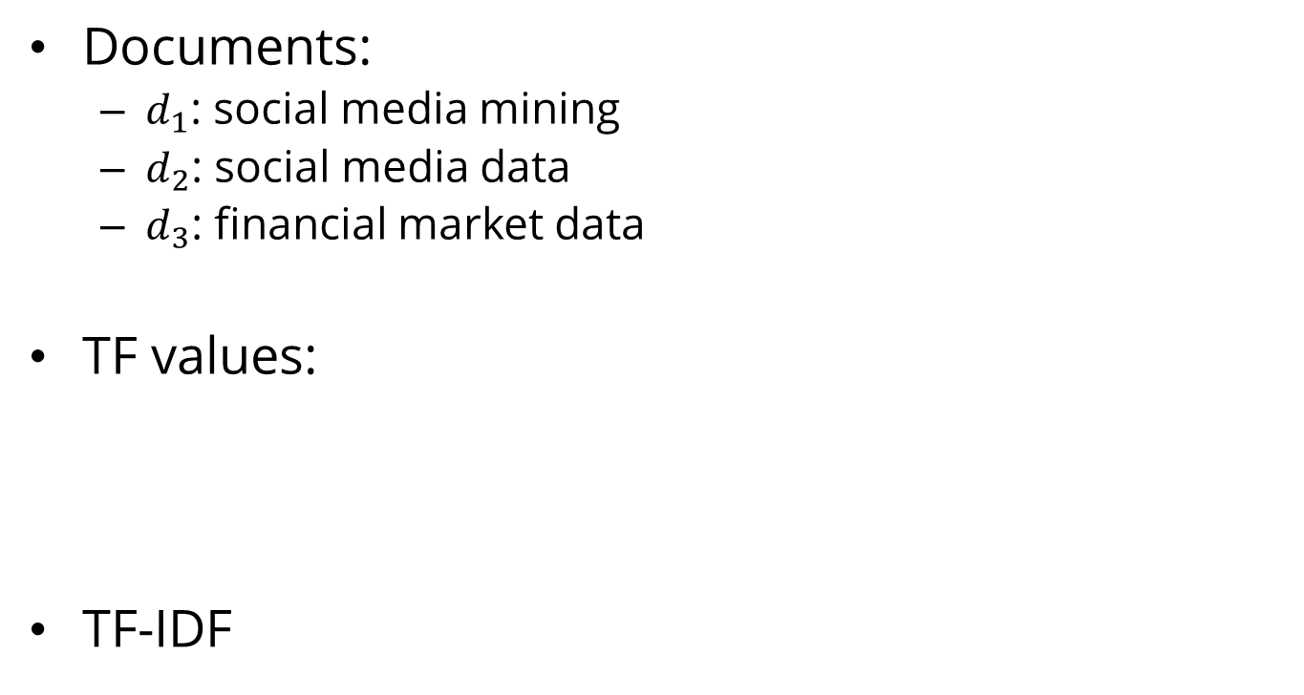
TF-IDF: An Example
Documents:
$d_{1}$: social media mining
$d_{2}$: social media data
$d_{3}$: financial market data
TF values:
TF-IDF

Slide 20
Data Quality
When making data ready for mining, data quality needs to be assured
Noise
Noise is the distortion of the data
Outliers
Outliers are data points that are considerably different from other data points in the dataset
Missing Values
Missing feature values in data instances
Solution:
Remove instances that have missing values
Estimate missing values, and
Ignore missing values when running data mining algorithm
Duplicate data

Slide 21
Data Preprocessing
Aggregation
It is performed when multiple features need to be combined into a single one or when the scale of the features change
Example: image width , image height -> image area (width x height)
Discretization
From continues values to discrete values
Example: money spent -> {low, normal, high}
Feature Selection
Choose relevant features
Feature Extraction
Creating new features from original features
Often, more complicated than aggregation
Sampling
Random Sampling
Sampling with or without replacement
Stratified Sampling: useful when having class imbalance
Social Network Sampling

Slide 22
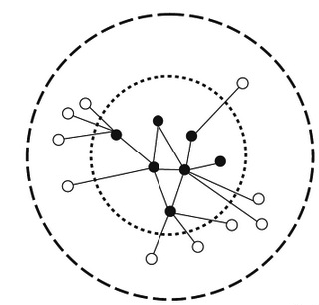
Data Preprocessing
Sampling social networks:
Start with a small set of nodes (seed nodes)
Sample
(a) the connected components they belong to;
(b) the set of nodes (and edges) connected to them directly; or
(c) the set of nodes and edges that are within n-hop distance from them.

Slide 23
Data Mining Algorithms

Slide 24
Data Mining Algorithms
Supervised Learning Algorithm
Classification (class attribute is discrete)
Assign data into predefined classes
Spam Detection
Regression (class attribute takes real values)
Predict a real value for a given data instance
Predict the price for a given house
Unsupervised Learning Algorithm
Group similar items together into some clusters
Detect communities in a given social network

Slide 25
Supervised Learning

Slide 26
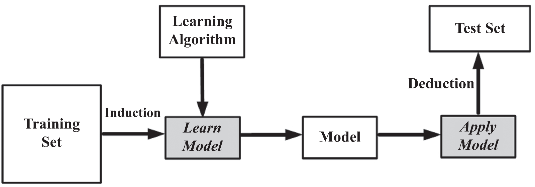
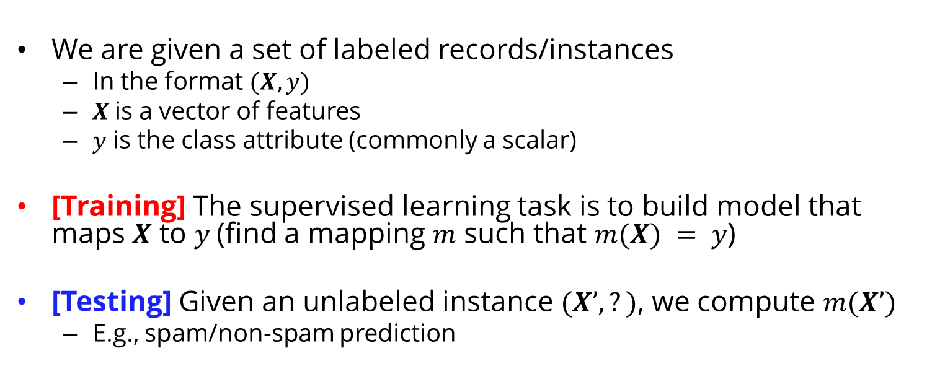
Supervised Learning: The Process
We are given a set of labeled records/instances
In the format $(X, y)$
$X$is a vector of features
$y$ is the class attribute (commonly a scalar)
[Training] The supervised learning task is to build model that maps $X$ to $y$(find a mapping $m$ such that $m(X) = y$)
[Testing] Given an unlabeled instance $(X’,?)$, we compute $m(X’)$
E.g., spam/non-spam prediction

Slide 27
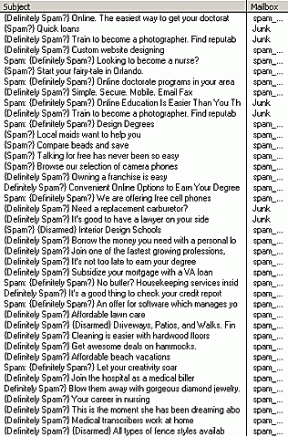
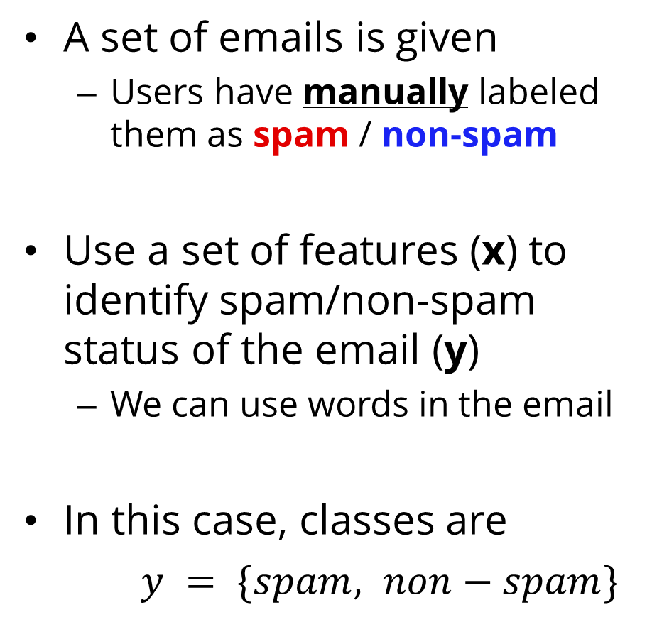
Classification: An Email Example
A set of emails is given
Users have manually labeled them as spam / non-spam
Use a set of features (x) to identify spam/non-spam status of the email (y)
We can use words in the email
In this case, classes are
$y = \{spam, non−spam\}$

Slide 28
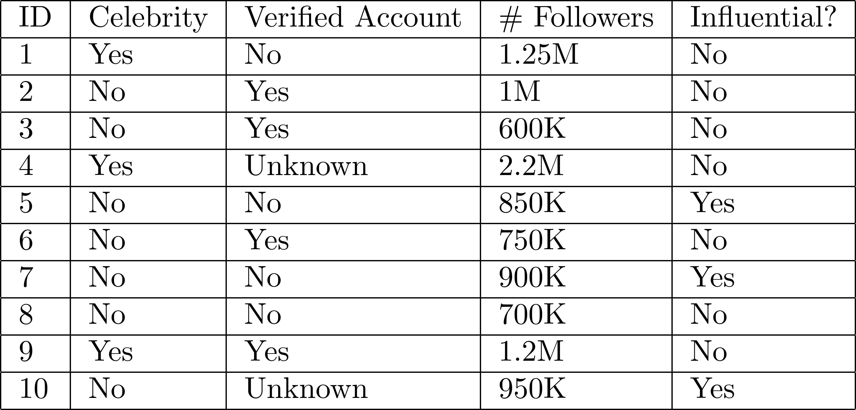
A Twitter Example

Slide 29
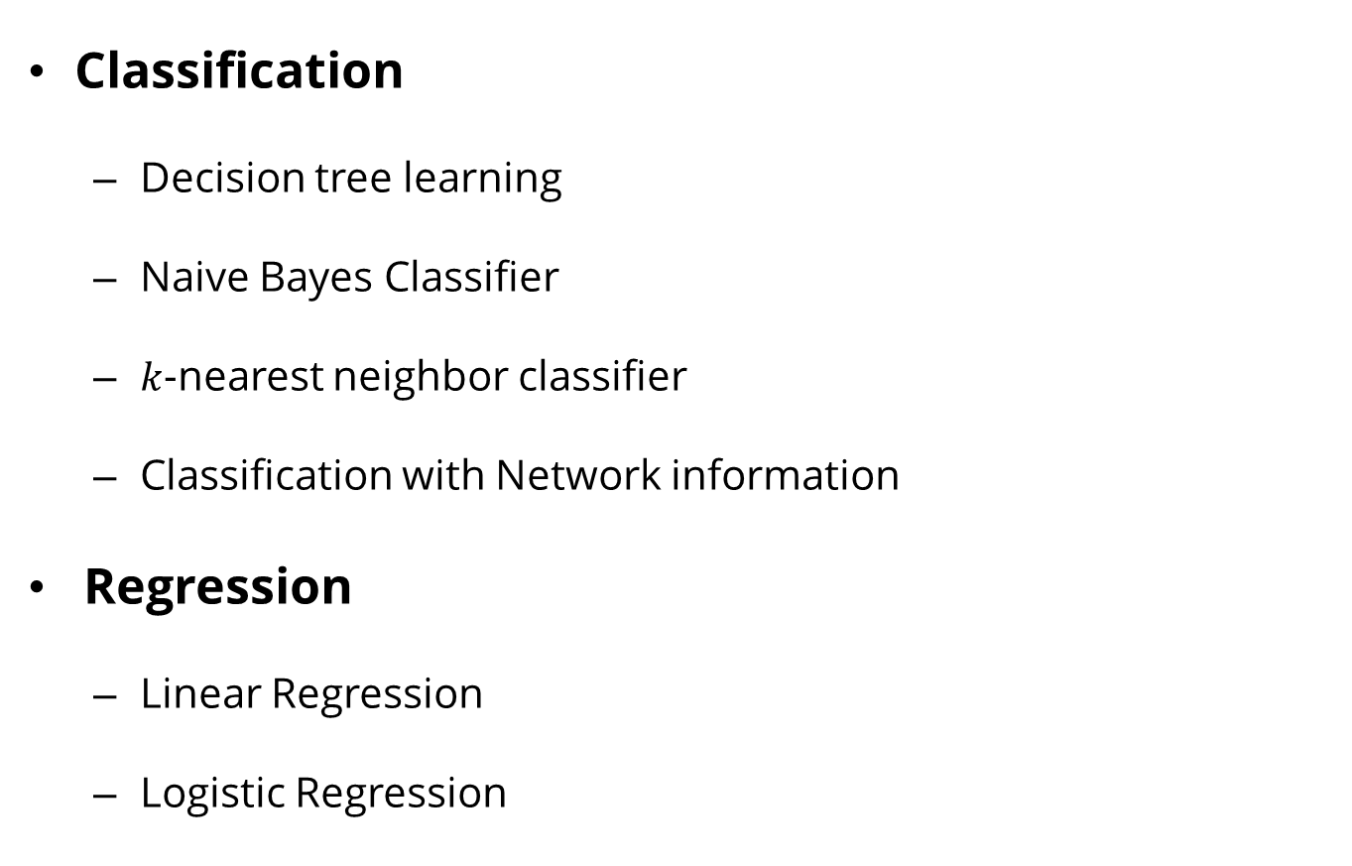
Supervised Learning Algorithms
Classification
Decision tree learning
Naive Bayes Classifier
$k$-nearest neighbor classifier
Classification with Network information
Regression
Linear Regression
Logistic Regression

Slide 30
Decision Tree Learning

Slide 31
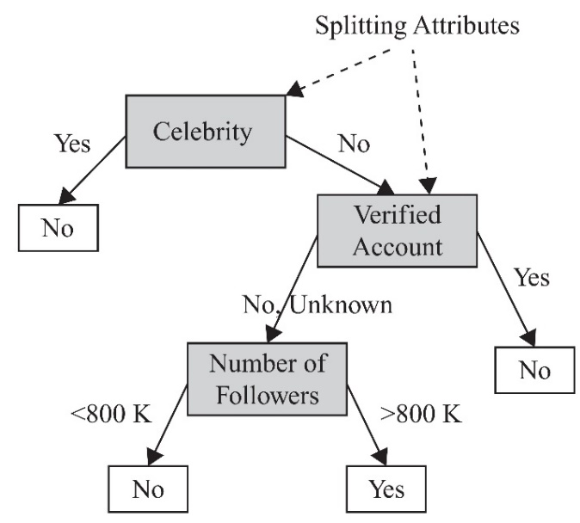
Decision Tree
A decision tree is learned from the dataset
(training data with known classes)
The learned tree is later applied to predict the class attribute value of new data
(test data with unknown classes)
Only the feature values are known

Slide 32
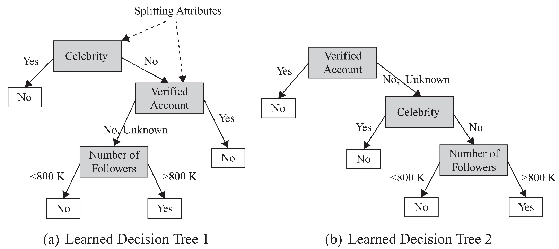
Decision Tree: Example
Multiple decision trees can be learned from the same dataset
Class Labels

Slide 33
Decision Tree Construction
Decision trees are constructed recursively
A top-down greedy approach in which features are sequentially selected.
After selecting a feature for each node,
based on its attribute values, different branches are created.
The training set is then partitioned into subsets based on the feature values,
each of which fall under the respective feature value branch;
The process is continued for these subsets and other nodes
When selecting features, we prefer features that partition the set of instances into subsets that are more pure.
A pure subset has instances that all have the same class attribute value.

Slide 34
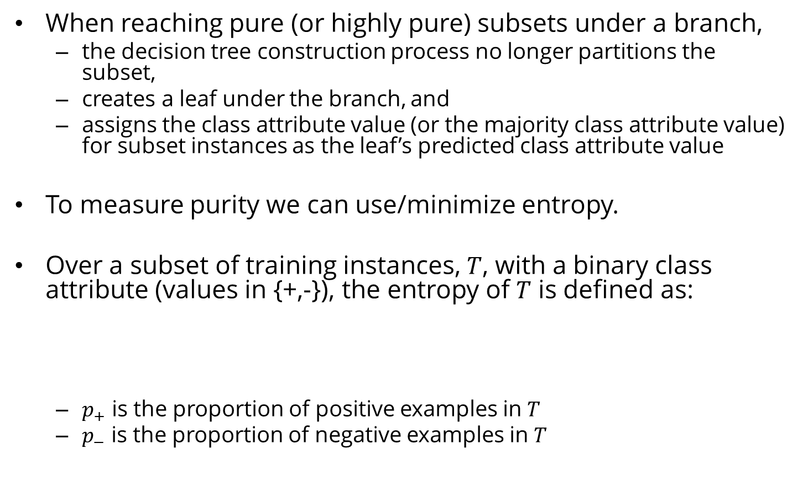
Decision Tree Construction
When reaching pure (or highly pure) subsets under a branch,
the decision tree construction process no longer partitions the subset,
creates a leaf under the branch, and
assigns the class attribute value (or the majority class attribute value) for subset instances as the leaf’s predicted class attribute value
To measure purity we can use/minimize entropy.
Over a subset of training instances, $T$, with a binary class attribute (values in {+,-}), the entropy of $T$ is defined as:
$p_{+}$ is the proportion of positive examples in $T$
$p_{−}$ is the proportion of negative examples in $T$

Slide 35
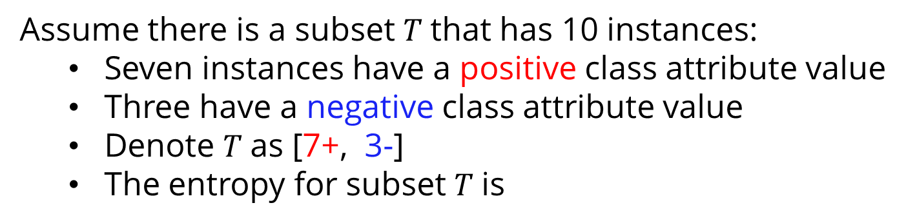
Entropy Example
Assume there is a subset $T$that has 10 instances:
Seven instances have a positive class attribute value
Three have a negative class attribute value
Denote $T$as [7+, 3-]
The entropy for subset $T$is
In a pure subset, all instances have the same class attribute value (entropy is 0)
If the subset contains an unequal number of positive and negative instances
The entropy is between 0 and 1.

Slide 36
Naïve Bayes Learning

Slide 37
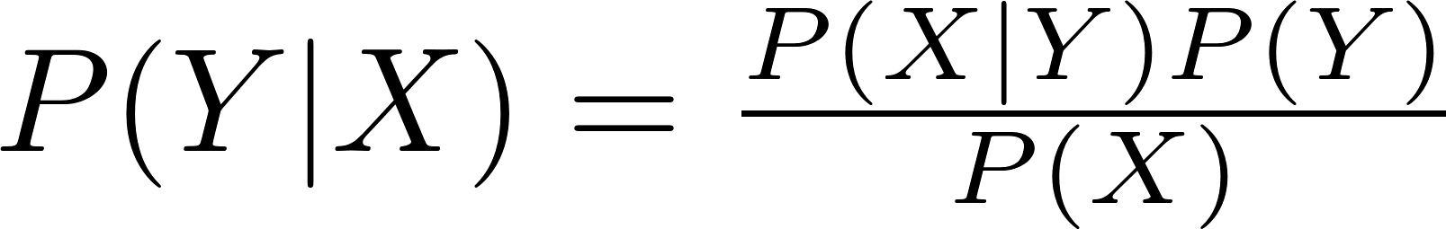
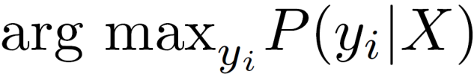
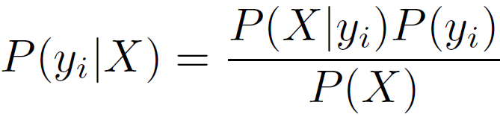
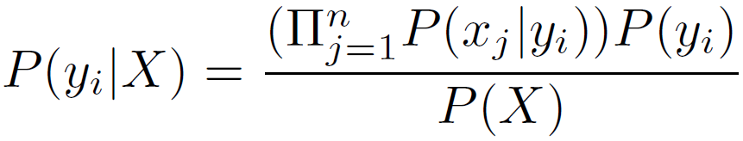
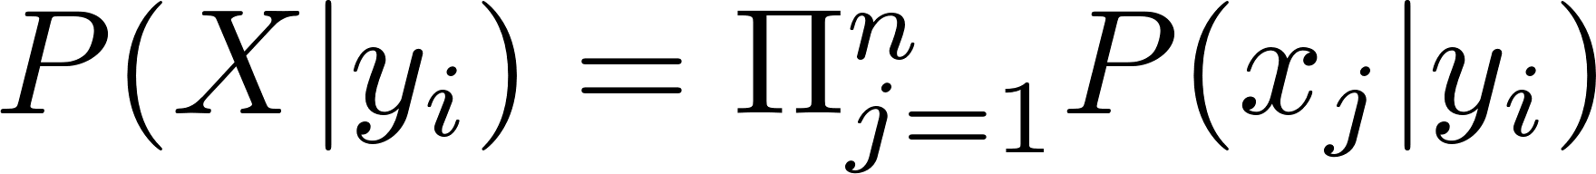
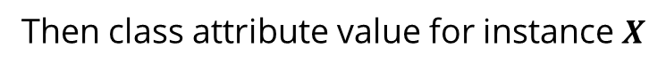
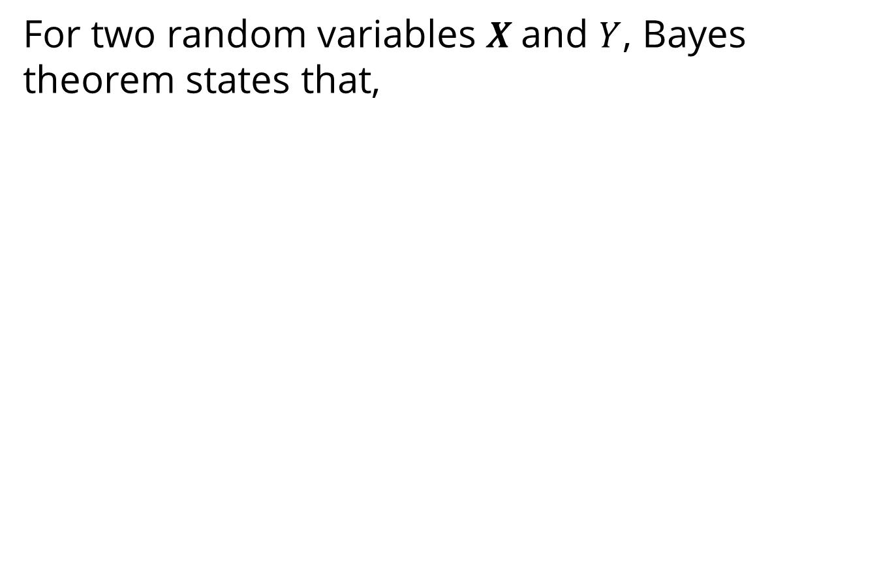
Naive Bayes Classifier
For two random variables $X$and $Y$, Bayes theorem states that,
class variable
the instance features
Then class attribute value for instance $X$
We assume that features are independent given the class attribute

Slide 38
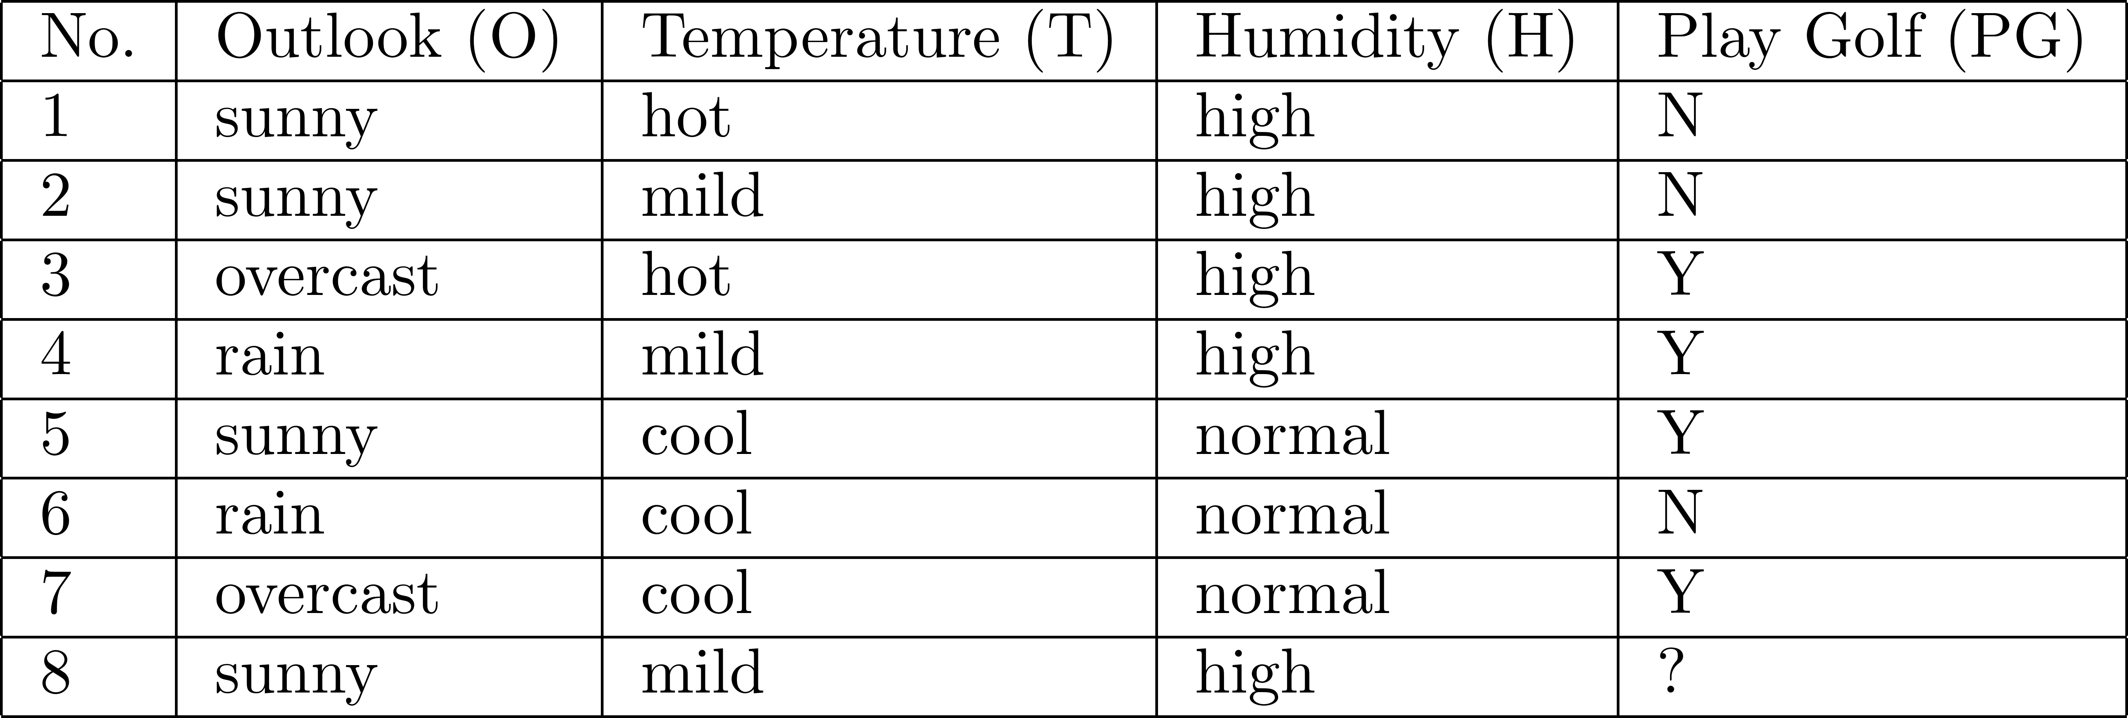
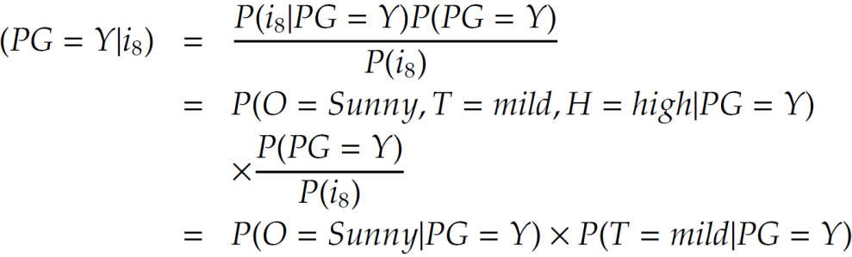
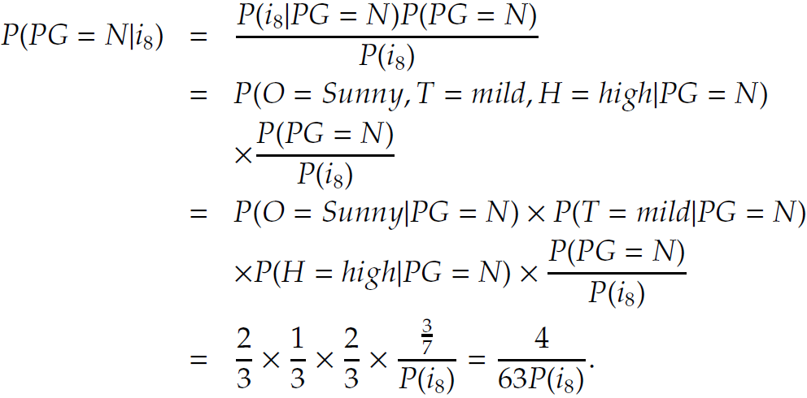
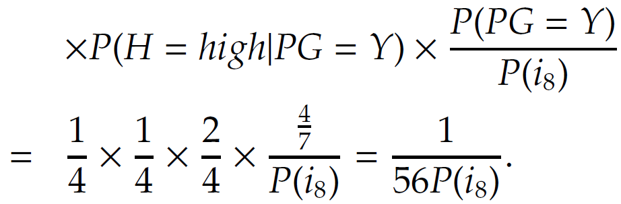
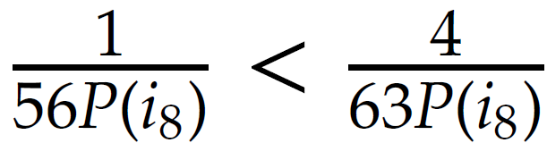
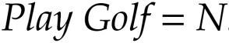
NBC: An Example

Slide 39
Nearest Neighbor Classifier

Slide 40
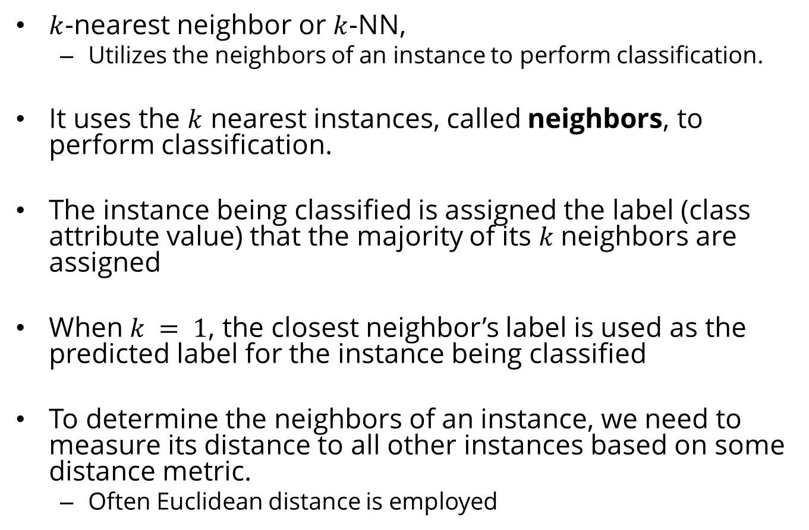
Nearest Neighbor Classifier
$k$-nearest neighbor or $k$-NN,
Utilizes the neighbors of an instance to perform classification.
It uses the $k$ nearest instances, called neighbors, to perform classification.
The instance being classified is assigned the label (class attribute value) that the majority of its $k$neighbors are assigned
When $k = 1$, the closest neighbor’s label is used as the predicted label for the instance being classified
To determine the neighbors of an instance, we need to measure its distance to all other instances based on some distance metric.
Often Euclidean distance is employed

Slide 41
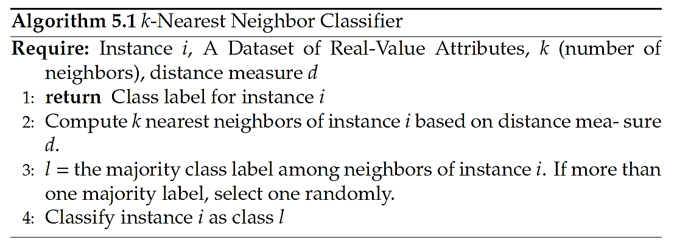
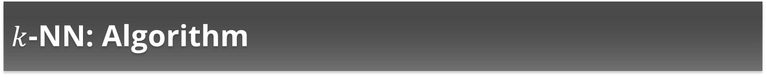
$k$-NN: Algorithm

Slide 42
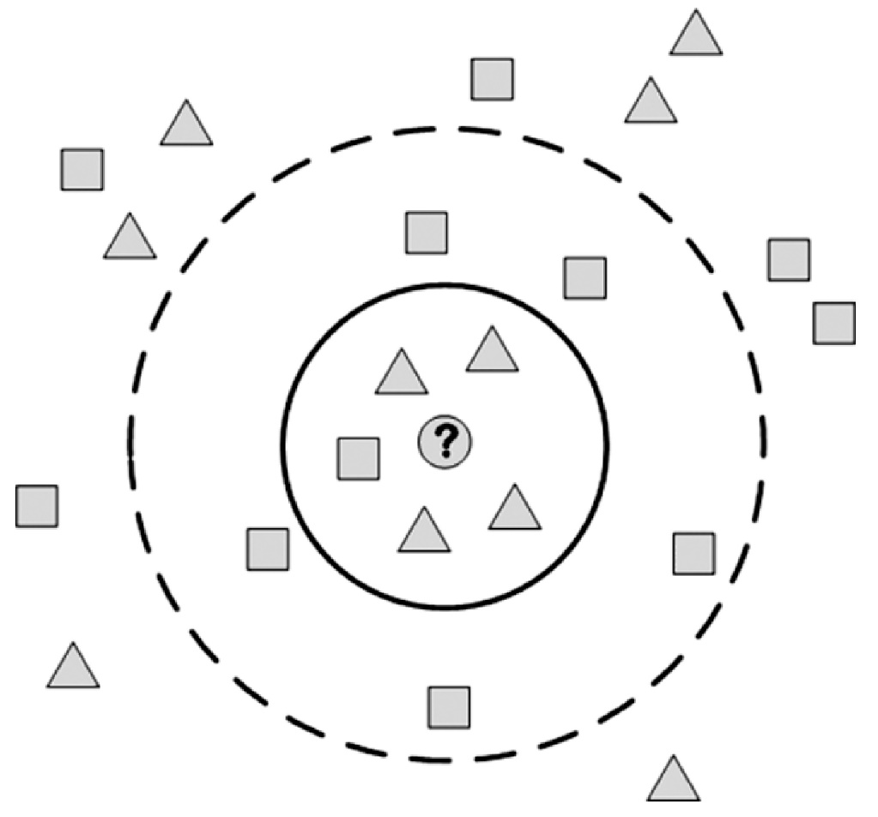
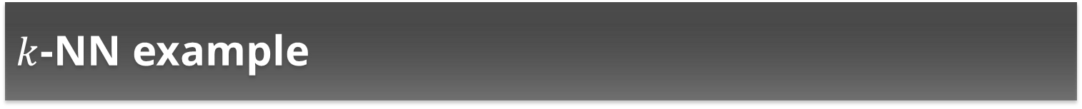
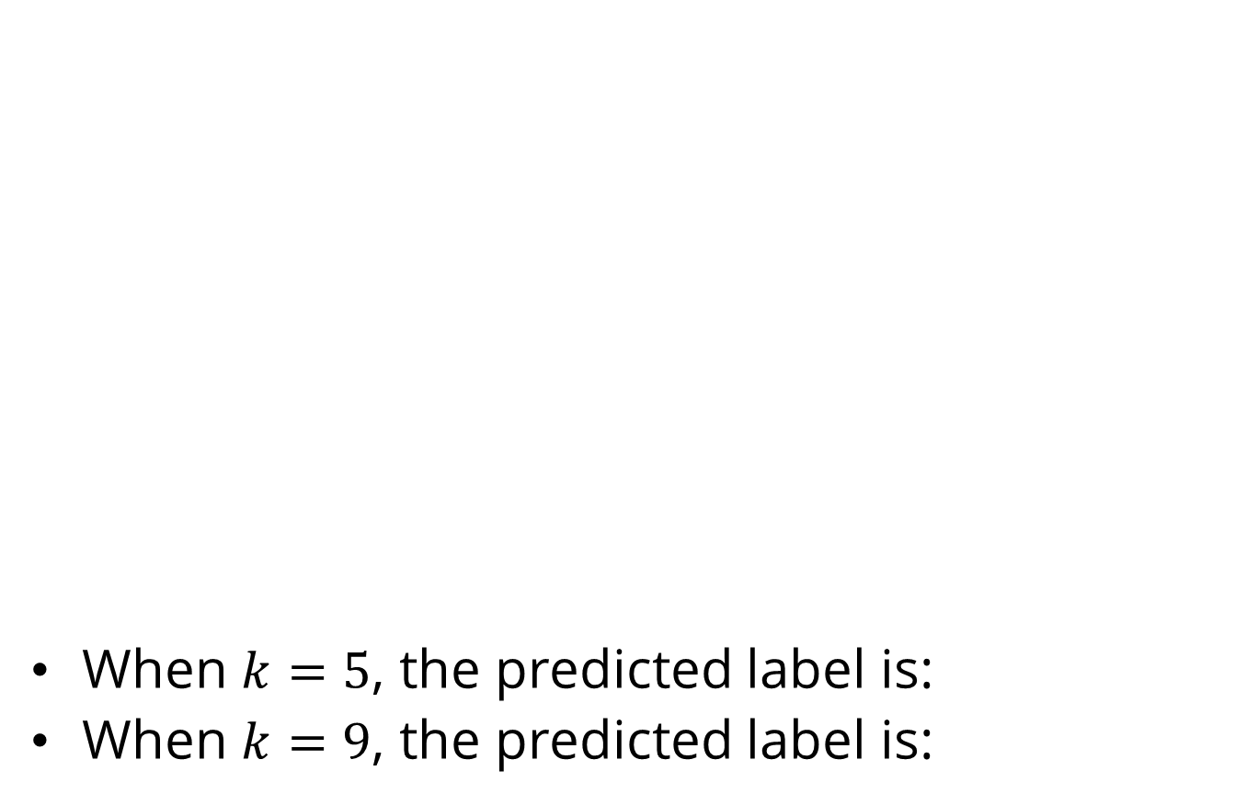
$k$-NN example
When $k=5$, the predicted label is:
When $k=9$, the predicted label is:
∆
□

Slide 43
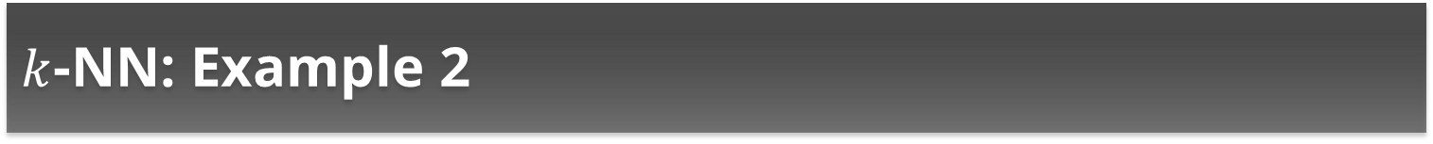
$k$-NN: Example 2
Similarity between row 8 and other data instances;
(Similarity = 1 if attributes have the same value, otherwise similarity = 0)
Data instance | Outlook | Temperature | Humidity | Similarity | Label | K | Prediction
2 | 1 | 1 | 1 | 3 | N | 1 | N
1 | 1 | 0 | 1 | 2 | N | 2 | N
4 | 0 | 1 | 1 | 2 | Y | 3 | N
3 | 0 | 0 | 1 | 1 | Y | 4 | ?
5 | 1 | 0 | 0 | 1 | Y | 5 | Y
6 | 0 | 0 | 0 | 0 | N | 6 | ?
7 | 0 | 0 | 0 | 0 | Y | 7 | Y
Notes:
Using the inverse of similarity as a distance measure

Slide 44
Classification with Network Information

Slide 45
Classification with Network Information
Consider a friendship network on social media and a product being marketed to this network.
The product seller wants to know who the potential buyers are for this product.
Assume we are given the network with the list of individuals that decided to buy or not buy the product. Our goal is to predict the decision for the undecided individuals.
This problem can be formulated as a classification problem based on features gathered from individuals.
However, in this case, we have additional friendship information that may be helpful in building better classification models

Slide 46
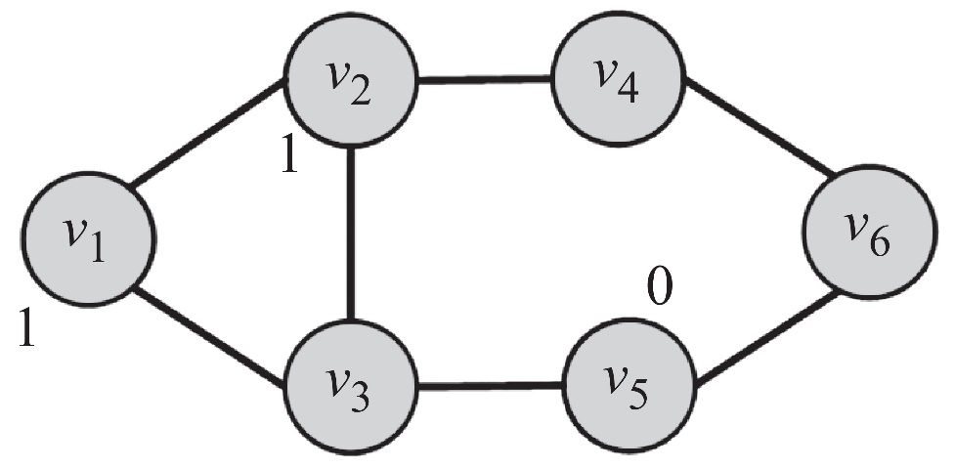
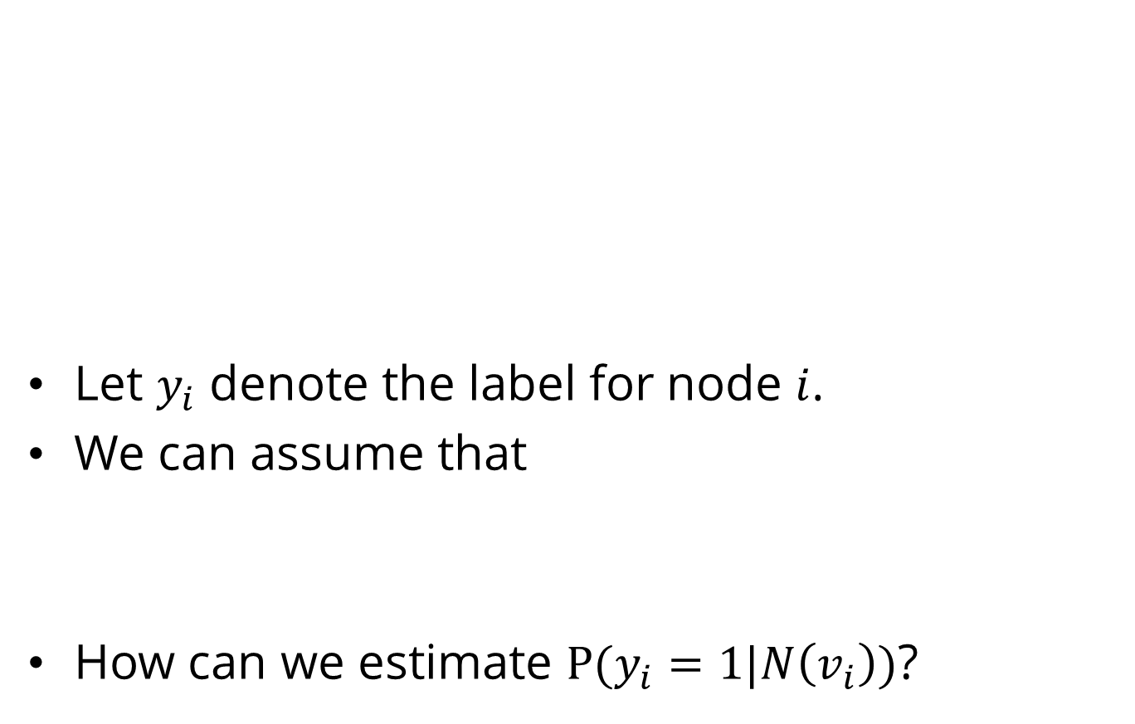
Classification with Network Information
Let $y_{i}$ denote the label for node $i$.
We can assume that
How can we estimate $P(y_{i}=1|N\left(v_{i}\right))$?

Slide 47
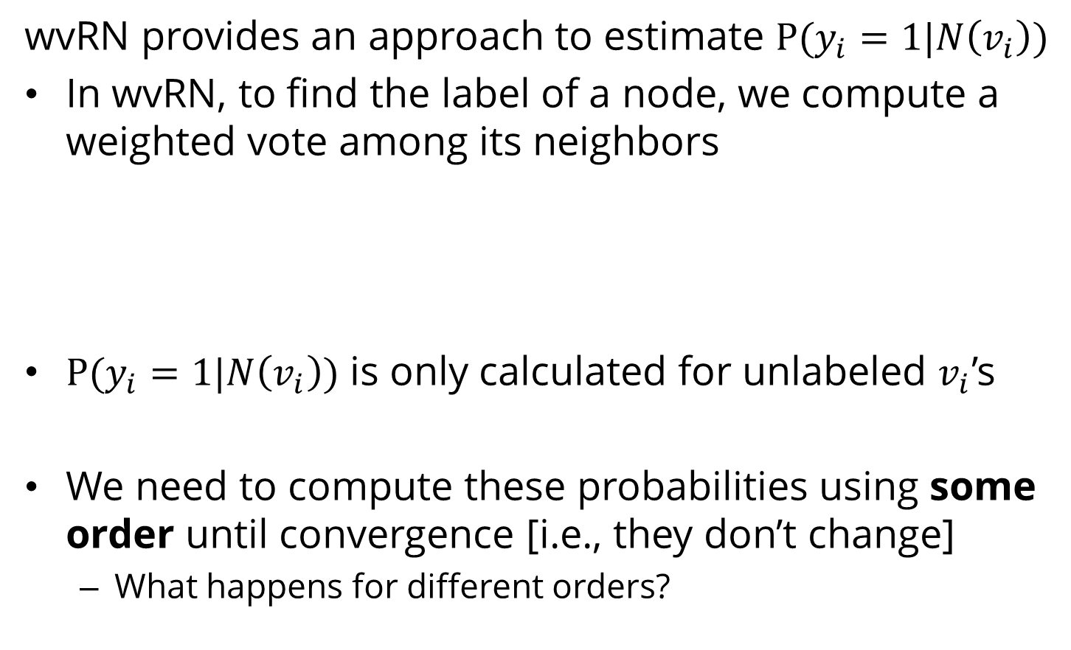
Weighted-vote Relational-Neighbor (wvRN)
wvRN provides an approach to estimate $P(y_{i}=1|N\left(v_{i}\right))$
In wvRN, to find the label of a node, we compute a weighted vote among its neighbors
$P(y_{i}=1|N\left(v_{i}\right))$ is only calculated for unlabeled $v_{i}$’s
We need to compute these probabilities using some order until convergence [i.e., they don’t change]
What happens for different orders?

Slide 48



wvRN example

Slide 49

wvRN example

Slide 50
Regression

Slide 51





Regression
In regression,
Class values are real numbers as class values
In classification, class values are categorical
$$y≈f(X)$$
Class attribute
(dependent variable)
$$yR$$
Features (regressors)
$$X=(x1, x2, …,xm)$$
Goal: find the relation between $y$ and vector $X=(x1, x2, …, xm)$

Slide 52


Linear Regression
Linear regression: we assume the relation between the class attribute $Y$ and feature set $X$is linear
$W$ represents the vector of regression coefficients
Regression can be solved by estimating $W$and $$using the provided dataset and the labels $Y$
“Least squares” is a popular method to solve regression
The goal is to minimize

Slide 53



Least Squares
Find $W$ such that minimizing ${ǁY − XWǁ}^{2}$for regressors $X$ and labels $Y$
Notes:
\frac{\partial}{\partial W} {(W^T X^T Y )} = X^T Y
\frac{\partial}{\partial W} { (W^T X^T X W) } = 2 X^T X W

Slide 54



Simplifying W with SVD
SVD of $X$
Notes:
SVD form of matrix X: X = U \Sigma V^T
U and V are real valued, they each are an orthogonal matrix
U^T = U^{-1}
V is orthogonal so: V^T^{-1} = V
(V \Sigma^2 V^T)^{-1} = V^T^{-1} \Sigma^{-2} V^T = V \Sigma^{-2} V^T

Slide 55




Logistic Regression
A probabilistic view of regression
Assuming the class attribute is binary, logistic regression finds the probability $p$
We can assume that $p$ can be obtained from $X$
Unbounded: $X$can take any values and $β$ is also unconstrained
$X$: Feature vector

Slide 56



Logistic Regression
Solution: transform $p$using $g(p)$, such that $g(p)$is unbounded
Fit $g(p)$using $βX$
Known an as the logit function
For any $p$ between $[0,1]$
$G(p)$is in range [$−∞,+∞$]

Slide 57


Logistic Regression
Logistic Function
Acts as a probability
Goal: Find $β$ such that $P(Y|X)$is maximized
No closed form solution
Iterative maximum likelihood
Prediction: once $β$ is determined compute $P(Y|X)$
For a binary class problem if it is more than 0.5, predict 1

Slide 58
Supervised Learning Evaluation

Slide 59
Evaluating Supervised Learning
Training/Testing Framework:
A training dataset (i.e., the labels are known) is used to train a model
the model is evaluated on a test dataset.
The correct labels of the test dataset are unknown,
In practice, the training set is divided into two parts,
One used for training and
The other used for testing.
When testing, the labels from this test set are removed.
After these labels are predicted using the model, the predicted labels are compared with the masked labels (ground truth).

Slide 60

Evaluating Supervised Learning
Dividing the training set into train/test sets
Leave-one-out training
Divide the training set into $k$equally sized partitions
Often called folds
Use all folds but one to train and the one left out for testing
$k$-fold cross validation training
Divide the training set into $k$equally sized sets
Run the algorithm $k$times
In round $i$, we use all folds but fold $i$for training and fold $i$for testing.
The average performance of the algorithm over $k$rounds measures the performance of the algorithm.

Slide 61


Evaluating Supervised Learning
As the class labels are discrete, we can measure the accuracy by dividing number of correctly predicted labels ($C$) by the total number of instances ($N$)
More sophisticated approaches of evaluation
AUC
F-Measure

Slide 62
Evaluating Regression Performance
The labels cannot be predicted precisely
We need to set a margin to accept or reject the predictions
Example. When the observed temperature is 71, any prediction in the range of 71±0.5 can be considered as a correct prediction
Or, we can use correlation between predicted labels and the ground truth.

Slide 63
Unsupervised Learning

Slide 64

Unsupervised Learning
Unsupervised division of instances into groups of similar objects
Clustering is a form of unsupervised learning
Clustering algorithms group together similar items
The algorithm does not have examples showing how the samples should be grouped together (unlabeled data)
Kernel Density Estimation

Slide 65
Measuring Distance/Similarity in Clustering
Clustering Goal: Group together similar items
Instances are put into different clusters based on the distance to other instances
Any clustering algorithm requires a distance measure
The most popular (dis)similarity measure for continuous features are Euclidean Distance and Pearson Linear Correlation
Euclidean Distance

Slide 66




Similarity Measures
$X$and $Y$ are $n$-dimensional vectors
Once a distance measure is selected, instances are grouped using it.

Slide 67

Clustering
Clusters are usually represented by compact and abstract notations.
“Cluster centroids” are one common example of this abstract notation.
Partitional Algorithms (most common type)
Partition the dataset into a set of clusters
Each instance is assigned to a cluster exactly once
No instance remains unassigned to clusters.
Example: $k$-means

Slide 68


$k$-means for $k=6$

Slide 69

$k$-means
The most commonly used clustering algorithm
Related to Expectation Maximization (EM) in statistics.

Slide 70


$k$-means: Algorithm
Given data points $xi$ and an initial set of $k$ centroids $m_{1}^{1},m_{2}^{1}$,…, $m_{k}^{1}$ the algorithm proceeds as follows:
Assignment step: Assign each data point to the cluster $S_{i}^{t}$ with the closest centroid
Each data point goes into exactly one cluster
Update step: Calculate the new means to be the centroid of the data points in the cluster
After all points are assigned

Slide 71
When do we stop?
The procedure is repeated until convergence
Convergence:
Whether centroids are no longer changing
Equivalent to clustering assignments not changing
The algorithm can be stopped when the Euclidean distance between the centroids in two consecutive steps is less than some small positive value

Slide 72



$k$-means (alternative!)
As an alternative, $k$-means implementations try to minimize an objective function.
Example: the squared distance error:
$x_{j}^{i}$ is the $j$th instance of cluster $i$
$n(i)$ is the number of instances in cluster $i$
$c_{i}$ is the centroid of cluster $i$.
Stopping Criterion:
when the difference between the objective function values of two consecutive iterations of the $k$-means algorithm is less than some small value .

Slide 73

$k$-means
Finding the global optimum of the $k$partitions is computationally expensive (NP-hard).
This is equivalent to finding the optimal centroids that minimize the objective function
Solution: efficient heuristics
Outcome: converge quickly to a local optimum that might not be global
Example: running $k$-means multiple times
Select the clustering assignment that is observed most often or
Select the clustering that is more desirable based on an objective function, such as the squared error.

Slide 74
Unsupervised Learning Evaluation

Slide 75

Evaluating the Clusterings
We are given two types of objects
In perfect clustering, objects of the same type are clustered together.
Evaluation with ground truth
Evaluation without ground truth

Slide 76
Evaluation with Ground Truth
When ground truth is available,
We have prior knowledge on what the clustering should be (the correct clustering assignments)
We will discuss these methods in community analysis chapter

Slide 77
Evaluation without Ground Truth
Cohesiveness
In clustering, we are interested in clusters that exhibit cohesiveness
In cohesive clusters, instances inside the clusters are close to each other
Separateness
We are also interested in clusterings of the data that generates clusters that are well separated from one another

Slide 78

Cohesiveness
Cohesiveness
In statistics: having a small standard deviation, i.e., being close to the mean value
In clustering: being close to the centroid of the cluster

Slide 79

Separateness
Separateness
In statistics: separateness can be measured by standard deviation
Standard deviation is maximized when instances are far from the mean
In clustering: cluster centroids being far from the mean of the entire dataset

Slide 80
Silhouette Index
We are interested in clusters that are both cohesive and separate
Silhouette index
It compares
the average distance value between instances in the same cluster
To
the average distance value between instances in different clusters
In a well-clustered dataset,
the average distance between instances in the same cluster is small (cohesiveness) and
the average distance between instances in different clusters is large (separateness).

Slide 81


Silhouette Index
For any instance $x$that is a member of cluster $C$
Compute the within-cluster average distance
Compute the average distance between $x$and instances in cluster $G$
$G$is closest to $x$in terms of the average distance between $x$and members of $G$

Slide 82


Silhouette Index
Our interest: clusterings where $a(x)<b(x)$
Silhouette can take values between $[−1,1]$
The best case happens when for all $x$,
$a(x)=0, b(x)>a(x)$

Slide 83





Silhouette Index - Example

